Slide 1
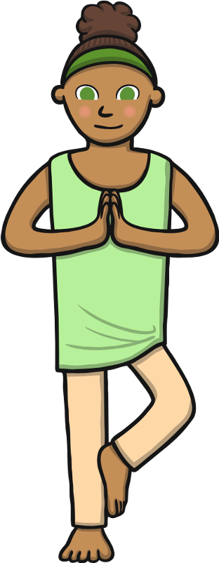
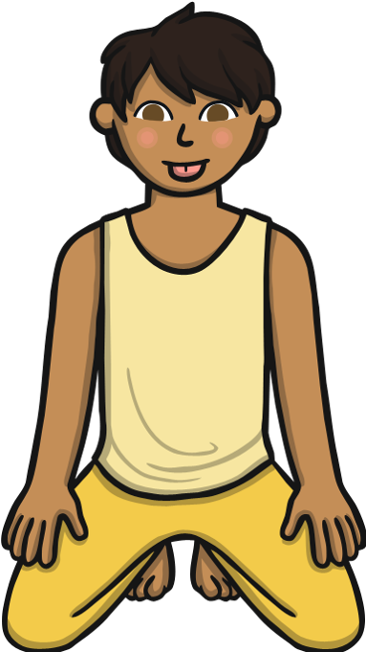
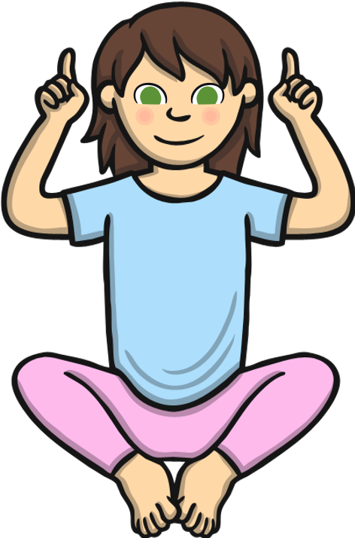

Slide 2
Preparation and Safety
Age | 5 - 11
National Curriculum | Develop balance, agility and co-ordination.
Time | Approximately 20 minutes but can be flexible according to age and session time.
Prep | Session to happen on a carpeted floor or mats with enough space to stretch out arms and legs. If possible, have a bag with animals, pictures and stories inside to promote discussion.
Safety | Hold each pose for at least two breaths and always change sides when instructed to. Keep breathing, move slowly into the pose, never overstretch and if any pain is felt stop immediately. Have Fun!
Script | Print the script to help prompt your yoga story. Or make up your own!

Slide 3
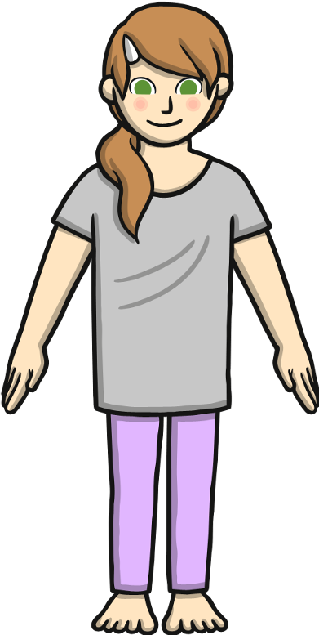
Mountain Pose
Tadasana
Benefits | Improves posture, strengthens core, muscles and legs.
1 | Stand tall with your weight balanced evenly on your feet.
2 | Firm your thigh muscles and pull in your tummy.
3 | Press your shoulders back and hang your arms beside your torso.
4 | Breathe deeply and hold as long as needed (at least two long breaths).

Slide 4
Giraffe Pose
Chair Pose: Utkatasana
Benefits | Strengthens legs, stretches shoulders and chest.
1 | Start in mountain pose.
2 | Exhale, and bend your knees as if you were sitting in a chair.
3 | Reach your arms towards the ceiling, with your palms facing each other.
4 | Hold this pose and breathe.

Slide 5
Tree Pose
Vriksasana
Benefits | Improves balance; strengthens thighs, calves, and ankles; stretches legs and chest; develops concentration.
1 | Begin in mountain pose.
2 | Lift your right foot, turning your knee out; place your foot below your left knee.
3 | Press your hands together.
4 | Raise arms overhead, and look up to your hands if possible.
5 | Return hands to your chest, and lower your right leg.
6 | Repeat with left leg.

Slide 6
Flamingo Pose
Rainbow Pose
Benefits | Stretches arms, abdominals, spine, and chest; calms the mind.
1 | Raise both hands over your head.
2 | Drop one hand by your side, exhale, and arch the other over your body.
3 | Hold this position.
4 | Repeat on the other side.

Slide 7
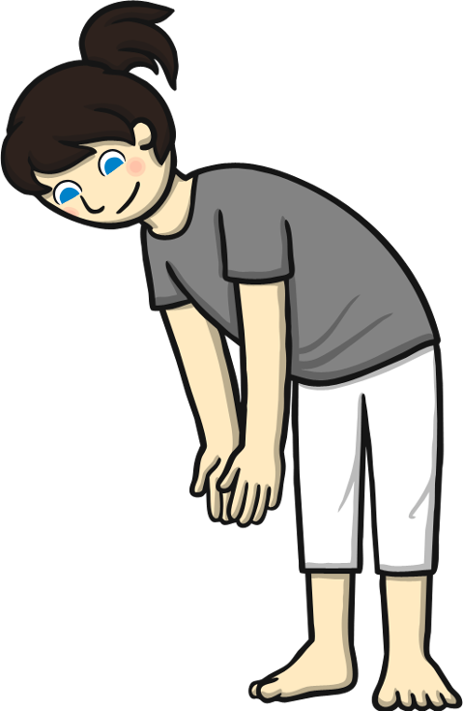
Elephant Pose
Rainbow Pose
Benefitsw | Stretches legs and back, relieves stress and calms the mind.
1 | Bend at the hips.
2 | Let arms hang low then claps fingers together.
3 | Swing arms from side to side like a trunk. Swing whole body from side to side to walk like an elephant.

Slide 8
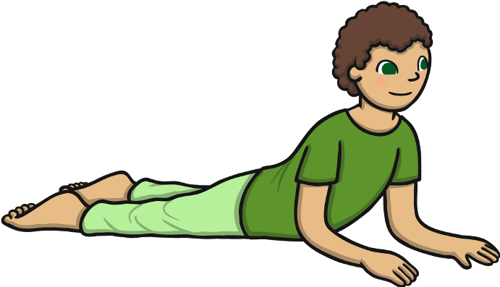
Snake Pose
Salabhasana
Benefits | Strengthens spine and backs of arms and legs; stretches shoulders, chest, and belly; improves posture; helps relieve stress.
1 | Begin by lying on your tummy.
2 | Exhale, and lift your head and upper torso off the floor.
3 | Gaze forward or slightly upward.
4 | Hold this position, then release.

Slide 9
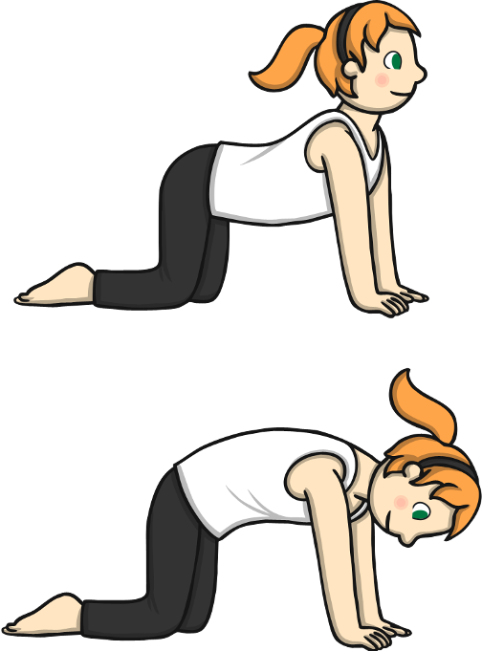
Zebra Pose
Cat Cow Pose: Marjaryasana Bitilasana
Benefits | Stretches torso and neck, gently massages spine and internal organs.
1 | Start by kneeling on hands and knees. Make sure hands are below shoulders, and knees are below hips.
2 | Inhale, look up to the ceiling, and allow your belly to sink toward the floor.
3 | Exhale, round your back towards the ceiling, and look at your belly.
4 | Repeat.

Slide 10
Lion Pose
Simhasana
Benefits | Stretches the hips, thighs, and ankles; calms the mind; relieves stress and fatigue.
1 | Start on your knees, then sit back onto your heels.
2 | Spread your fingers out and press your palms into your knees.
3 | Take a deep breath in through your nose.
4 | Open your mouth, stretch out your tongue, open your eyes wide, and let out your breath through your mouth with a silent "ROAR".
5 | Repeat a few times.

Slide 11
Butterfly Pose
Benefits | Calms the body and mind, helps relieve stress, headaches and fatigue.
1 | Begin by sitting with soles of feet together.
2 | Touch fingers to the side of your head.
3 | Gently bounce your knees to flap your butterfly wings, and move your fingers to wiggle your butterfly antennae.
4 | Exhale, and slowly lower your hands back to your lap.

Slide 12
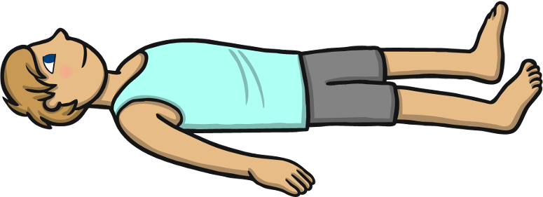
Relaxation Under a Tree
Resting Pose: Savasana
Benefits | Calms the body and mind, helps relieve stress, headaches and fatigue.
1 | Lay down on your back, with arms next to your body and legs slightly apart.
2 | Close your eyes, focus on deep breathing and relaxation. For full benefit, relax for 2-5 minutes depending on age.

